Slide 1
Microsoft 365® Security Monitoring
Protecting staff wherever they are

Slide 2
Introduction

Slide 3
We all know…
Data Security is of great importance to any business
Businesses are at risk if there is a data breach

Slide 4
The world has changed…
More and more businesses use Microsoft 365® not just inside the office, but when working from home or remotely.
It’s not easy to monitor devices and laptops when they are aren’t inside an office network.

Slide 5
The world has changed…
Often, compliance relies on proving you keep data secure regardless of staff locations.
Companies often don’t have the skills or time to monitor their Microsoft 365 tenancy.
Cyber criminals are increasingly using cloud technologies to gain access to company information or perpetrate fraud and theft.

Slide 6
What’s the solution?

Slide 7
What we need is a way of monitoring the security of Microsoft 365 users regardless of their location.

Slide 8
Microsoft 365® Security Monitoring
Enterprise Grade Security for your Microsoft 365 tenancy at an Entry Level Price

Slide 9
Microsoft 365® Monitoring
Keep users protected and secure regardless of where they are working
Accounts will be secure - even for remote workers
Remote users will be protected in the same way as those working within an office network

Slide 10
How it works…
The only Microsoft 365 Monitoring Service backed by a 24/7/365 fully staffed SOC
AI and ML sifting through millions of events
Human eyes checking things that don’t look right

Slide 11
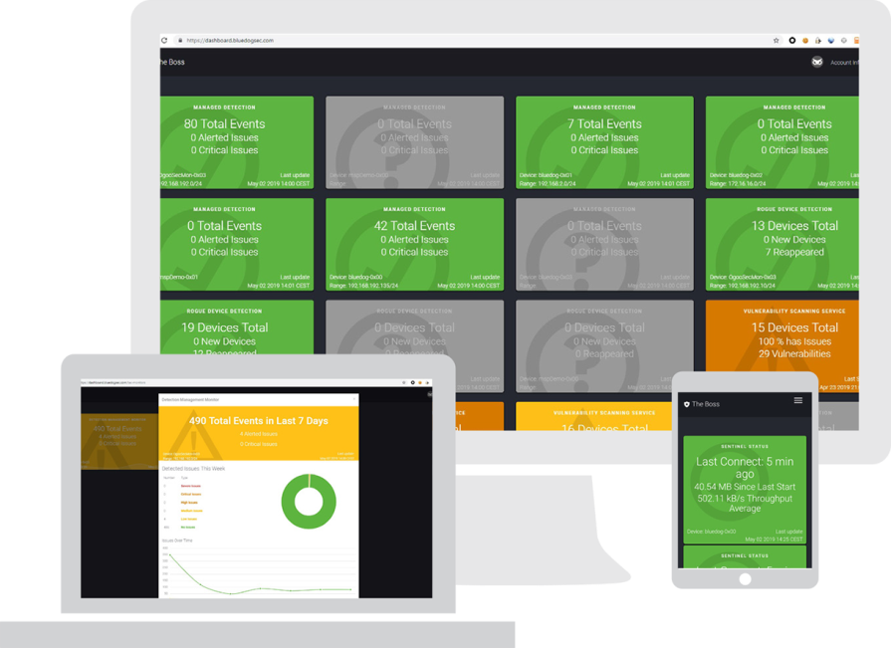
How it works…
Bluedog provides a dashboard of events – available anywhere, anytime
Advanced security for any subscription level of Microsoft 365

Slide 12
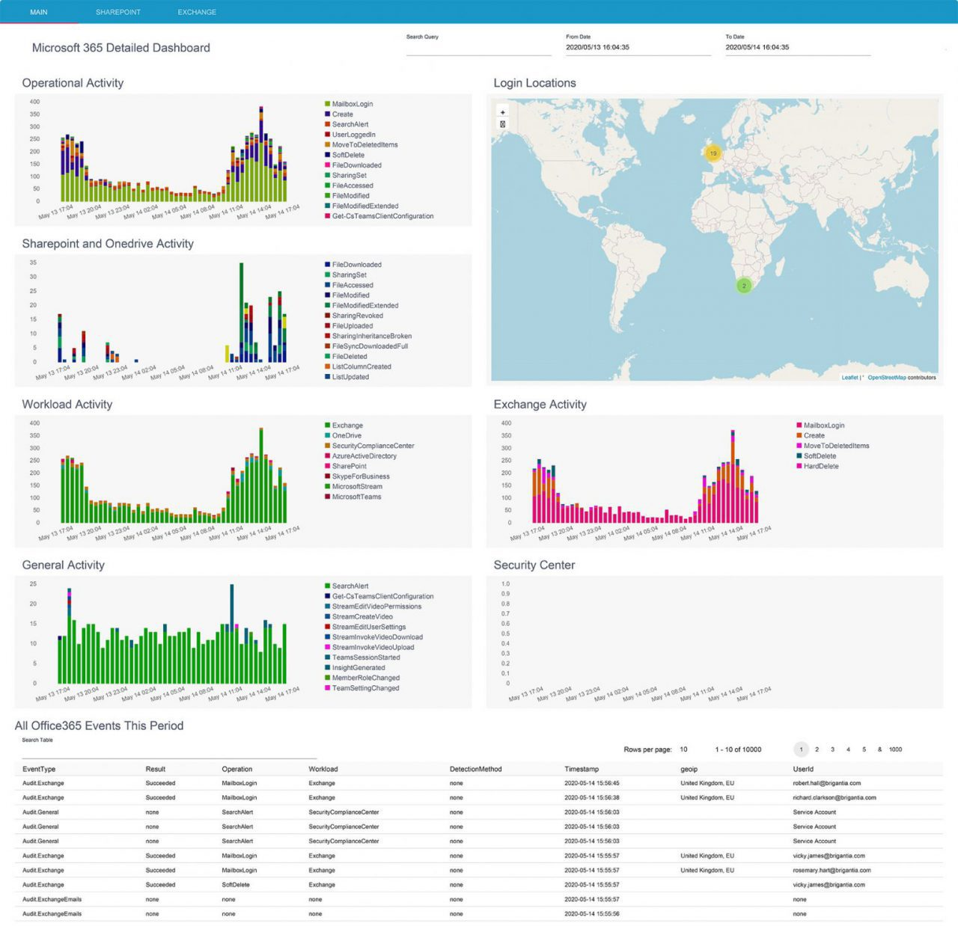
How it works…
Drill down into events:
Login locations
Failed Logins
Rule creations
Account creations

Slide 13
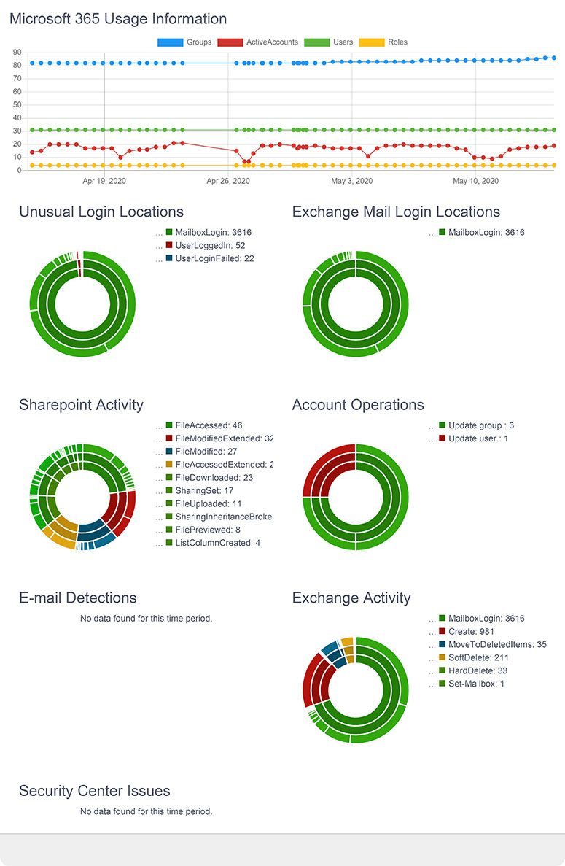
How it works…
Account and Email events
Sharepoint Activity
Does it look right?
Alerts can be actioned
Fair usage: Average Active Accounts

Slide 14
Summary
Monitoring service backed by a 24/7/365 SOC.
Protect employees working outside the company network
Advanced security for any subscription level of Microsoft 365 tenancy.
Uses AI, ML but most importantly humans to investigate, alert and remediate unusual activity.

Slide 15
Bluedog is ISO27001 Certified
Notes:
For your peace of mind, Bluedog Security Monitoring is certified to ISO27001

Slide 16
“Security is about people, not technology”
Tim Thurlings
Co-Founder & CTO, Bluedog Security Monitoring

