Slide 1
bluedog Security Monitoring
Cyber Security Monitoring for all

Slide 2
Who we are?

Slide 3


We are a cybersecurity company that provides essential security monitoring services to resource constrained businesses and organisations.
Our continuous monitoring and analysis of threats and anomalies provides exceptional peace of mind to business owners, leaders and IT teams.

Slide 4
Our business centres
London, UK
Rotterdam, Netherlands
Manila, Philippines

Slide 5
What is VAPT?
Vulnerability Assessment and Penetration Testing.
Bluedog’s Automated VAPT is a combination of our External Vulnerability Scanning (EVS) and our WebApp Scanning Service (WSS)
Scans your public facing network and website / webapp.

Slide 6
The power of VAPT
VAPT is a more Comprehensive Testing Solution
Helps you Prioritize Risks
Uncovers Misconfigurations and Loopholes
Has Excellent ROI
Helps with Compliance
Notes:
With VAPT, it’s easier to discover and mitigate critical vulnerabilities across platforms and software types, even third-party ones
Risk prioritization is an integral part of VAPT. A good VAPT strategy addresses and emphasizes this step by clearly marking which threats and which risks should be tackled first.
Most exploitable vulnerabilities are due to misconfigurations or incorrect coding practices. Both of these things can be present in your own applications or in third-party ones.
VAPT run by a third-party company is the easiest way to spot them and address them before they become chronic issues or, worse, before an attacker is successful. Choose your VAPT provider carefully, though. You need to work with a company that cuts no corners when it comes to the skill sets of the engineers they hire.
Do you know what happens to the money you invest in cyber security? Probably not. In fact, it’s one of the fields that’s notorious for hard to pinpoint ROI. As long as no attacks happen, you consider it money well invested.
And you’re not wrong.
But, thanks to its comprehensive approach, VAPT can tell you exactly how much money you saved by choosing an integrative approach instead of disparate testing methods, for instance. Or how much, on average, a successful attack might have cost you.
An increasing number of companies use VAPT as the surest and fastest way to achieve compliance with various standards like GDPR, ISO 27001 and PCI DSS. Even if conducted solely for compliance purposes, VAPT will still spot major vulnerabilities and can help you keep your assets safe.

Slide 7
Why is a regular scan important?
Over 300 new vulnerabilities are found every day.
August 2020 – 915,510 items tested per scan
September 2020 - 961,721 items tested per scan
January 2021 - 1,014,123 items tested per scan
Imagine how far behind you will be after a year!
Notes:
Over 300 new vulnerabilities are found each and every day, in websites, hardware, firmware, even networking software and firewalls. An attacker can easily find out what hardware you use and the version of software and they’ll have an exploit they can run against it unless you have plugged the hole!
In August 2020 the bluedog Vulnerability scan tested 915,510 items per scan, within a month that had gone up to over 960,000 by the start of 2021 it topped a million!
This why regular monthly scans are so vital, because an annual pen test or scan will leave you vulnerable to too many risks.

Slide 8
Key features of bluedog VAPT
Over a million different checks are performed each scan.
Updated for new issues daily from multiple trusted sources.
Performs active reconnaissance.
Scans against direct exploitation.
Performs partial authentication and authorization bypass.
Provides detail over time.
Notes:
A bluedog automated scan performs over 1 millions different checks each time it runs
The scans are updated daily so that we are always using the very latest scan knowledge
The scan performs active reconnaissance, which means that the scan looks around the network or website first to see what assets there are.
The scan tests the network or website’s ability to resist a list of known exploits which are software or security flaws, which are a way an attacker could get into your network or website maybe with admin privelages.
Authentication bypass vulnerability could allow attackers to perform various malicious operations by bypassing the device authentication mechanism, this is also checked by the scan.
The results are shown in the dashboard and over time you will see how your security maturity is growing as you understand more about the state of your network and website.

Slide 9
Key features of bluedog VAPT
See the full details of each scan via our dashboard and generate reports anytime.
Handles the false positives.
Provides descriptions, insights, detection, summary, solutions, and other hosts with the same issue in one view.
Reviewed and overseen by the bluedog 24/7 Security Operation Centre.
Up and running almost instantly
Notes:
The full details of each scan are available at any time, and you can also generate a printable PDF.
The bluedog SOC and our own AI handles the false positives for you, something that usually wastes a huge amount of time!
Not only do you get full descriptions but you are given the solutions to each of the issues.
The fully staffed bluedog SOC is operationally 24/7/365 and all bluedog services are overseen by the SOC.
Ordering bluedog VAPT is really easy, all we need is the IP addresses and website URL.

Slide 10
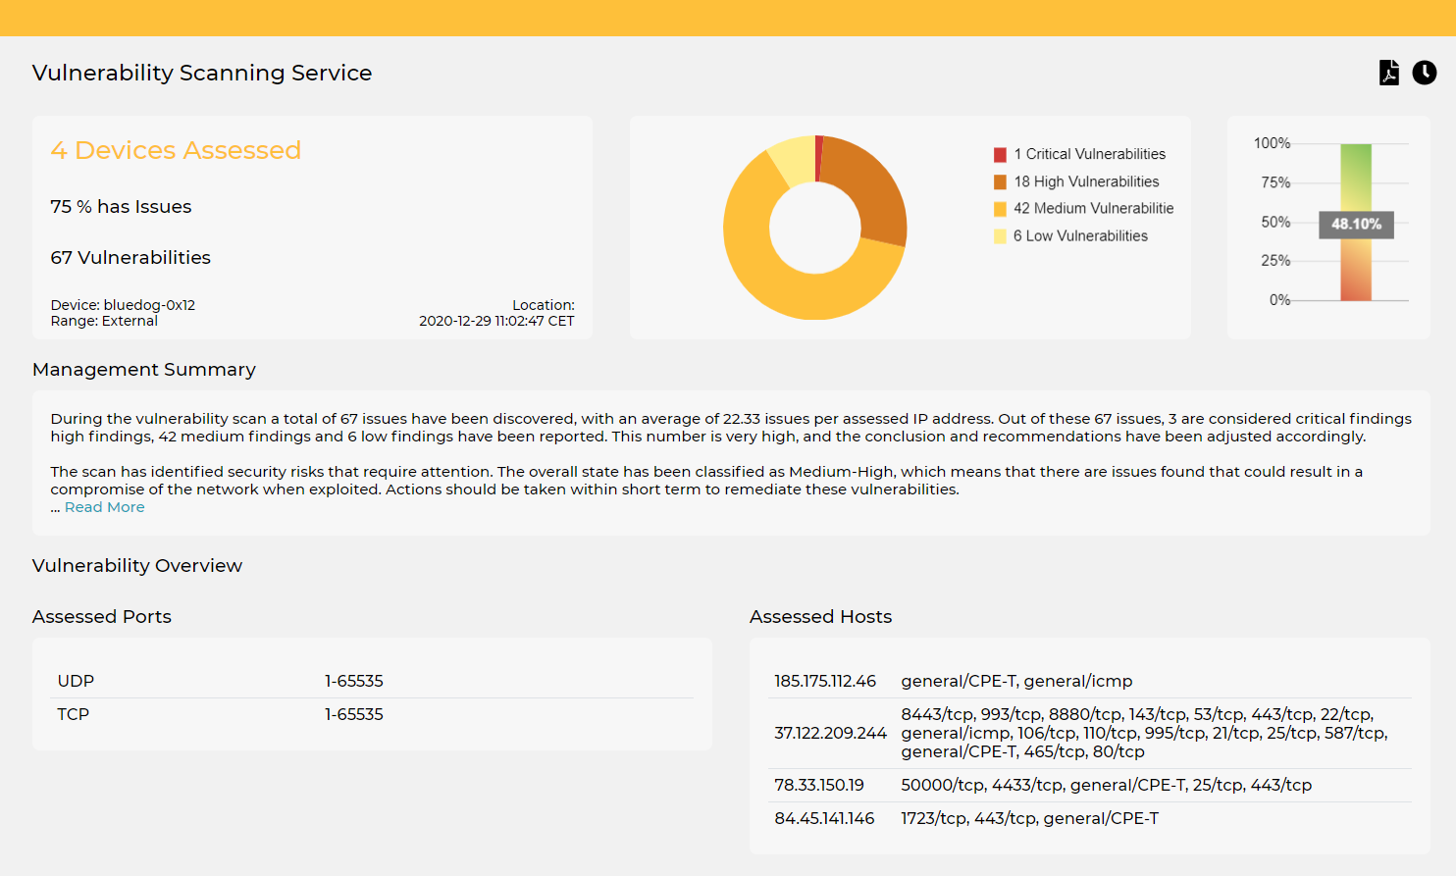
Notes:
So, when Bluedog’s scan runs it produces an interactive report on the Bluedog Dashboard which you can log into and view.
The report consists of an easy to view summary, a comprehensive Management Summary and a list of all the vulnerabilities found.

Slide 11
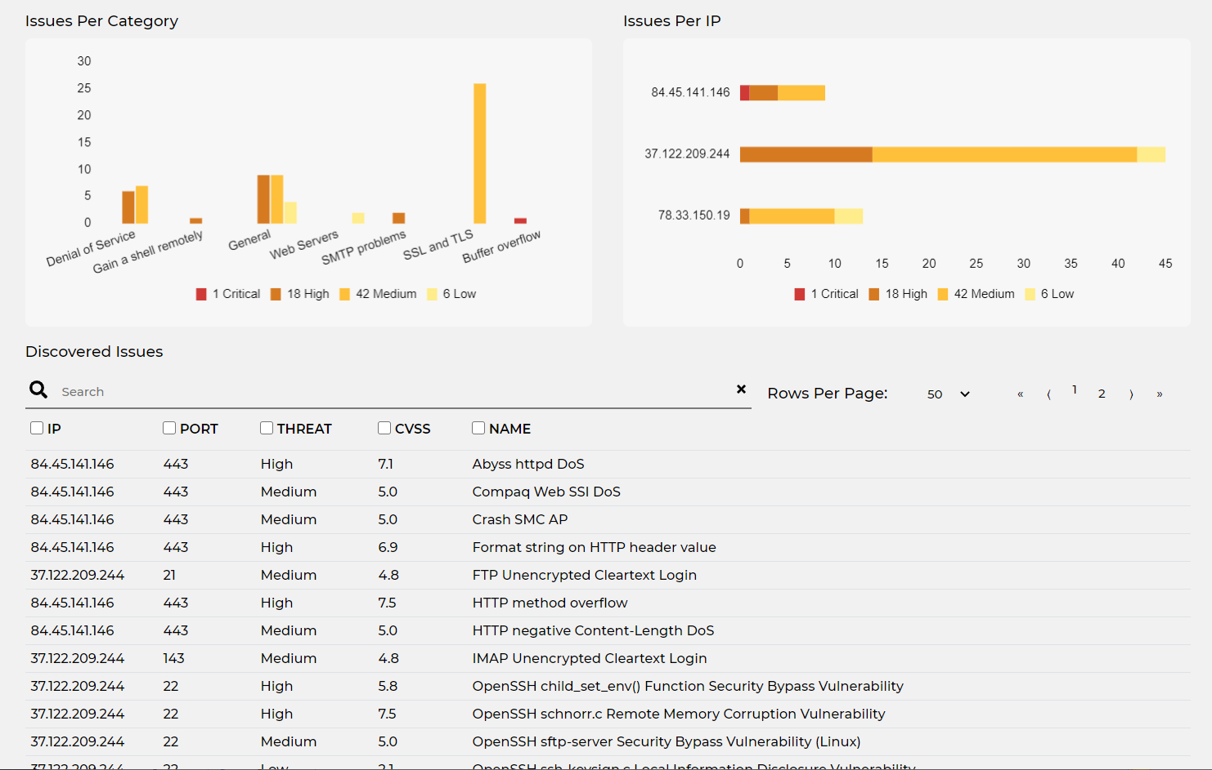
Notes:
This shows the summary of issues discovered from a typical scan.
The priority level is also shown, and you simply click on the line to see the detail.

Slide 12
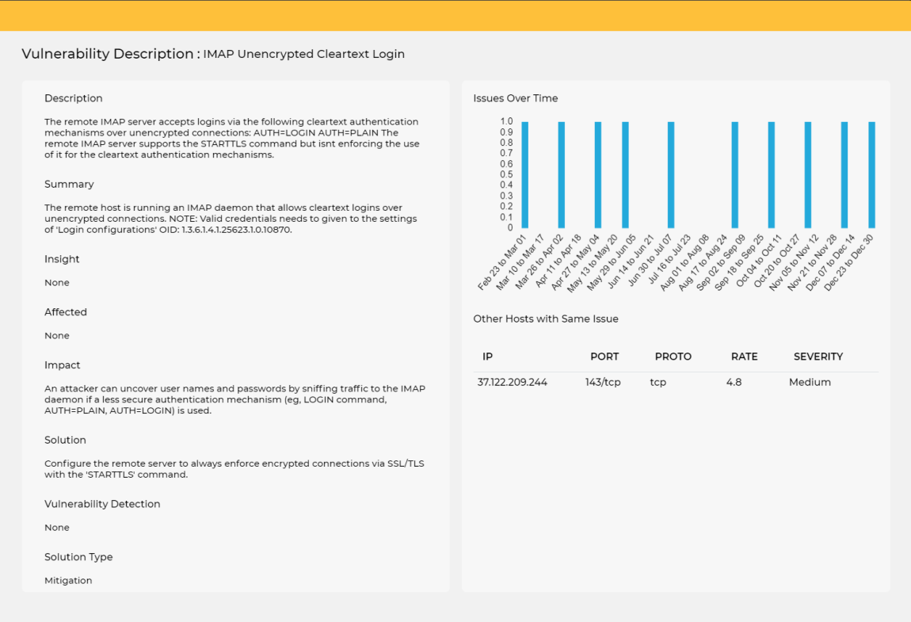
Notes:
This is the detail of just one issue.
As you can see, there is a detailed description, and summary, a description of the potential impact of this issue and most importantly there is a clear solution as to how to resolve this issue.
You can also see how this issue changed over time.

Slide 13
Benefits of Bluedog VAPT
Find your vulnerabilities before attackers do
Save thousands on expensive dedicated security engineers
Protect your business from life threatening cyber criminals
Maintain your defences on a regular basis, not just once per year
Saves you time by giving you the solution to each vulnerability

Slide 14

Bluedog is ISO27001 Certified
Notes:
For your peace of mind, Bluedog Security Monitoring is certified to ISO27001

Slide 15
Bluedog VAPT Services
 | Essential VAPT | Pro VAPT | One-Off VAPT | Manual VAPT
Type | Automated VAPT | Automated VAPT | Automated VAPT | Manual VAPT (with VPN Connection)
Frequency | Monthly Scan | Monthly Scan | One-off Scan | One-off Penetration Test
Features | Includes all key features | Includes all key features | Includes all key features | Includes all key features, fully customisable
Scope | Scans up to 4 IPs and 1 website | Scans up to 16 IPs and 1 website | Scans up to 16 IPs and 1 website | Custom IP Ranges
 | Low Monthly Subscription | Low Monthly Subscription | One-Off Fee | Daily Rate

Slide 16
Summary
VAPT is the way forward for businesses to protect themselves from cyber attacks.
The bluedog suite of VAPT services protects your business.
The low price points allows any business to take advantage of Bluedog’s professional VAPT services.

